Slide 1
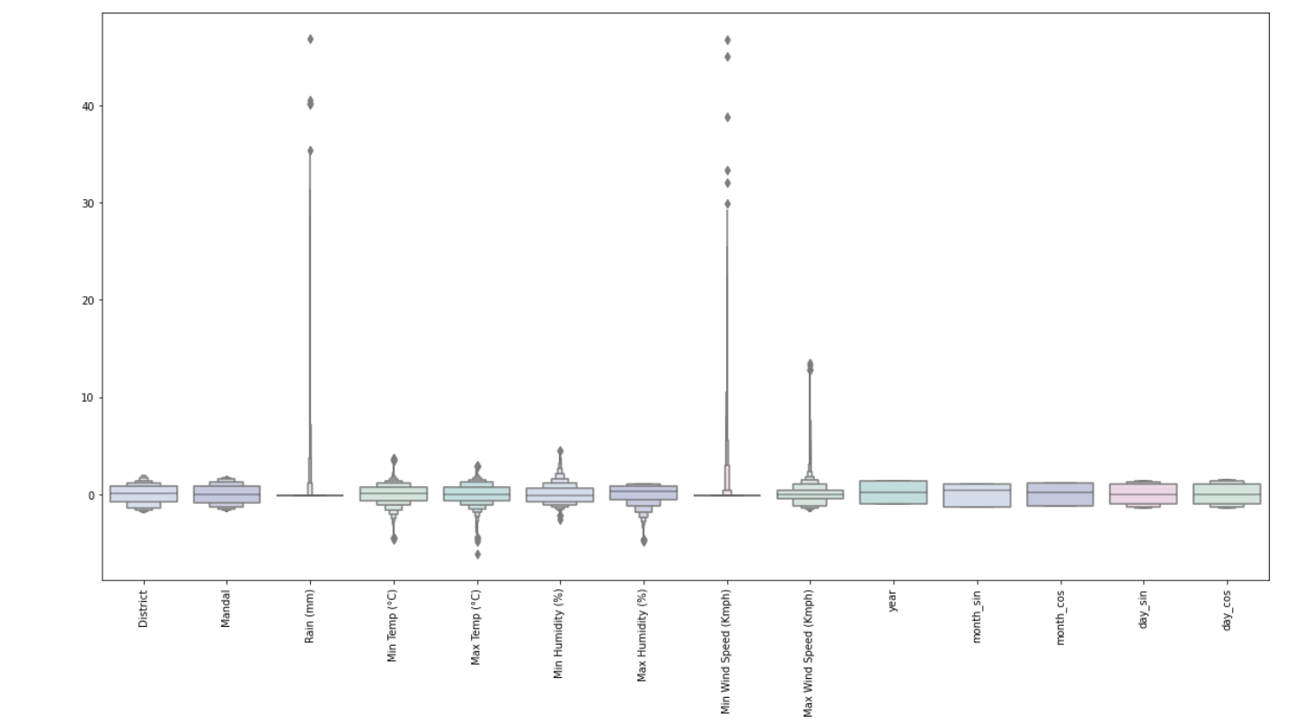
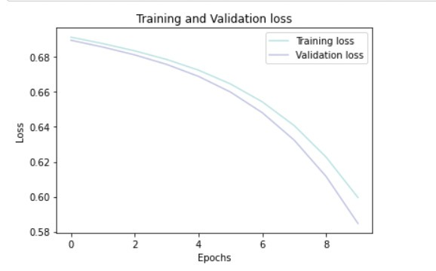
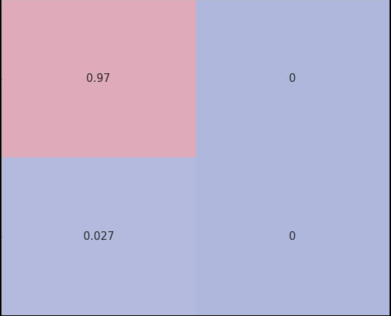
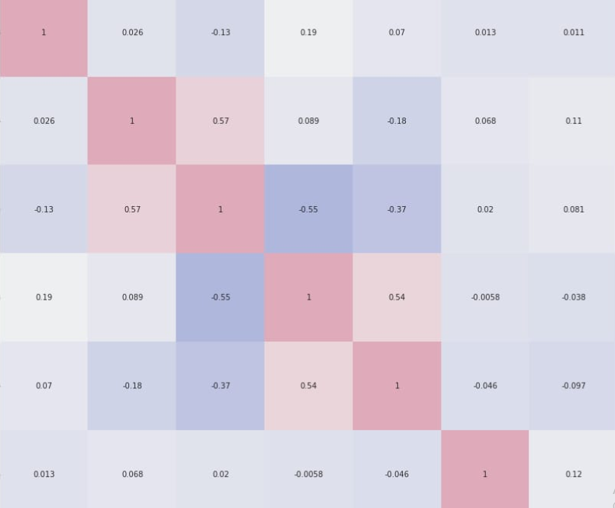

SDG 13 CLIMATE ACTION
Completed by: DeBuggers
Kaushal,Anirudh,Ankan,Tarun
INTRODUCTION:
Our team worked on the topic 'Climate Change'.
We analysed the given data and tried to predict the chances of rain in the next day.
METHODS:
The programming language we used is Python.
We used tools like:
* matplotlib
* sklearn
* keras
* pandas
* numpy
We have also used and trained our own Neural Network each with 4 layers using relu and sigmoid functions.
we have classified them district and mandal wise by using the nn to predict rainfall.
Each layer has 32 units and dense network.
EXTENSIONS
1) We have prepared a dataset from jan to march for the period 2018-21 this can be extended for all the months and longer period. 2. Try adding more hidden layers and try making the model more robust. 3. We can even establish a relationship from the satellite predictions including cyclone data, etc. 4. Can even try establishing a relationship between the available data and thermal imaging of cloud.
TAKEAWAYS:
The windspeed and humidity put a great affect in predicting rainfall.
The prediction of rainfall can be estimated at a very high rate in the month between Jan and march in the last 3 yeas.
DATASET:
Our team used:
1)TS Open weather data 2021
2)TS Open Rainfall data
2021
3)TS Open Weather 2020
4) TS Open Weather Data 2019
5)TS Open Weather Data 2018
RESULTS:
We successfully predicted the chances of rain in the next day by analysing the data of the previous days.
We have trained 10 epochs and gained an accuracy of 97.25 with a minimal loss of 0.5995
Our total time
REFERENCES:
https://data.telangana.gov.in/
https://www.kaggle.com/
http://data8.org/datascience/

